Slide 1
What’s the problem?
+

Slide 2
Top Stories

Slide 3
We are working on!!

Slide 4
Let our future breathe a relief
Be the first, join to inspire other.
JOIN the team
The right are not only for humans
Lets get together to save our mother Earth
Your one step will save your ones future

Slide 5
1 Seed = 1000 of fruits for generations! Invest now
Invest

Slide 6
Get into the competitions

Slide 7
Our initiative

Slide 8
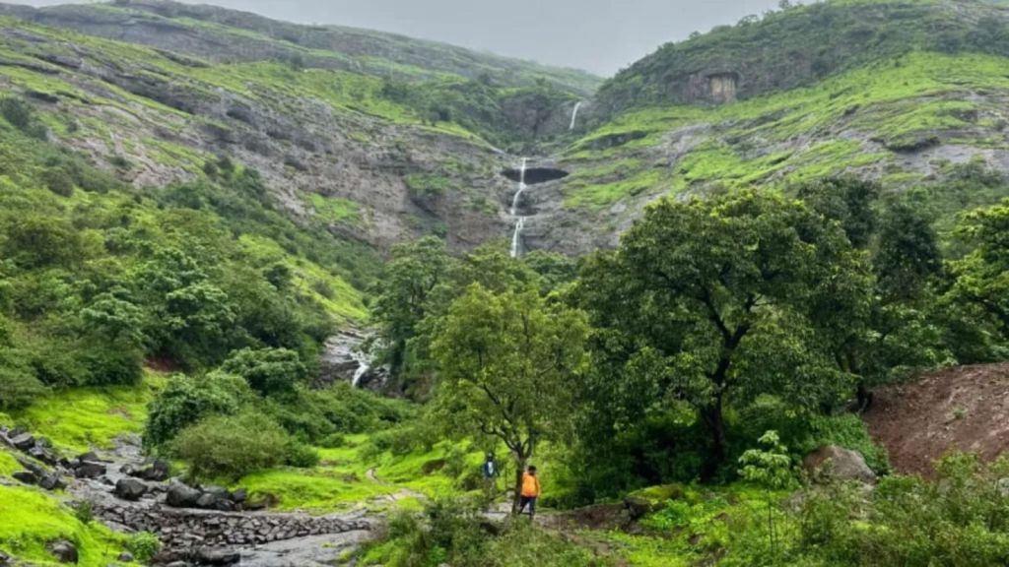
Maharashtra clears 83,700 sq ft forest land for 2 Adani Group projects.
Nearly 70,000 sq ft includes reserved forest and mangrove land in Raigad for Adani Cementation’s proposed cement terminal; another 13,800 sq ft of forest land cleared for a gas pipeline in Amravati.

Slide 9
Maharashtra(India) clears 83,700 sq ft forest land for 2 Adani Group projects.
Nearly 70,000 sq ft includes reserved forest and mangrove land in Raigad for Adani Cementation’s proposed cement terminal; another 13,800 sq ft of forest land cleared for a gas pipeline in Amravati.
By: Express News Service Mumbai Aug 11, 2026 07:00 AM IST

Slide 10

Local Voice
COMMUNITY CONNECT
‘s

Slide 11


